Slide 1


Smart Controls, Seamless Operations
Achieving Operational Excellence through Digital Controls

Slide 2
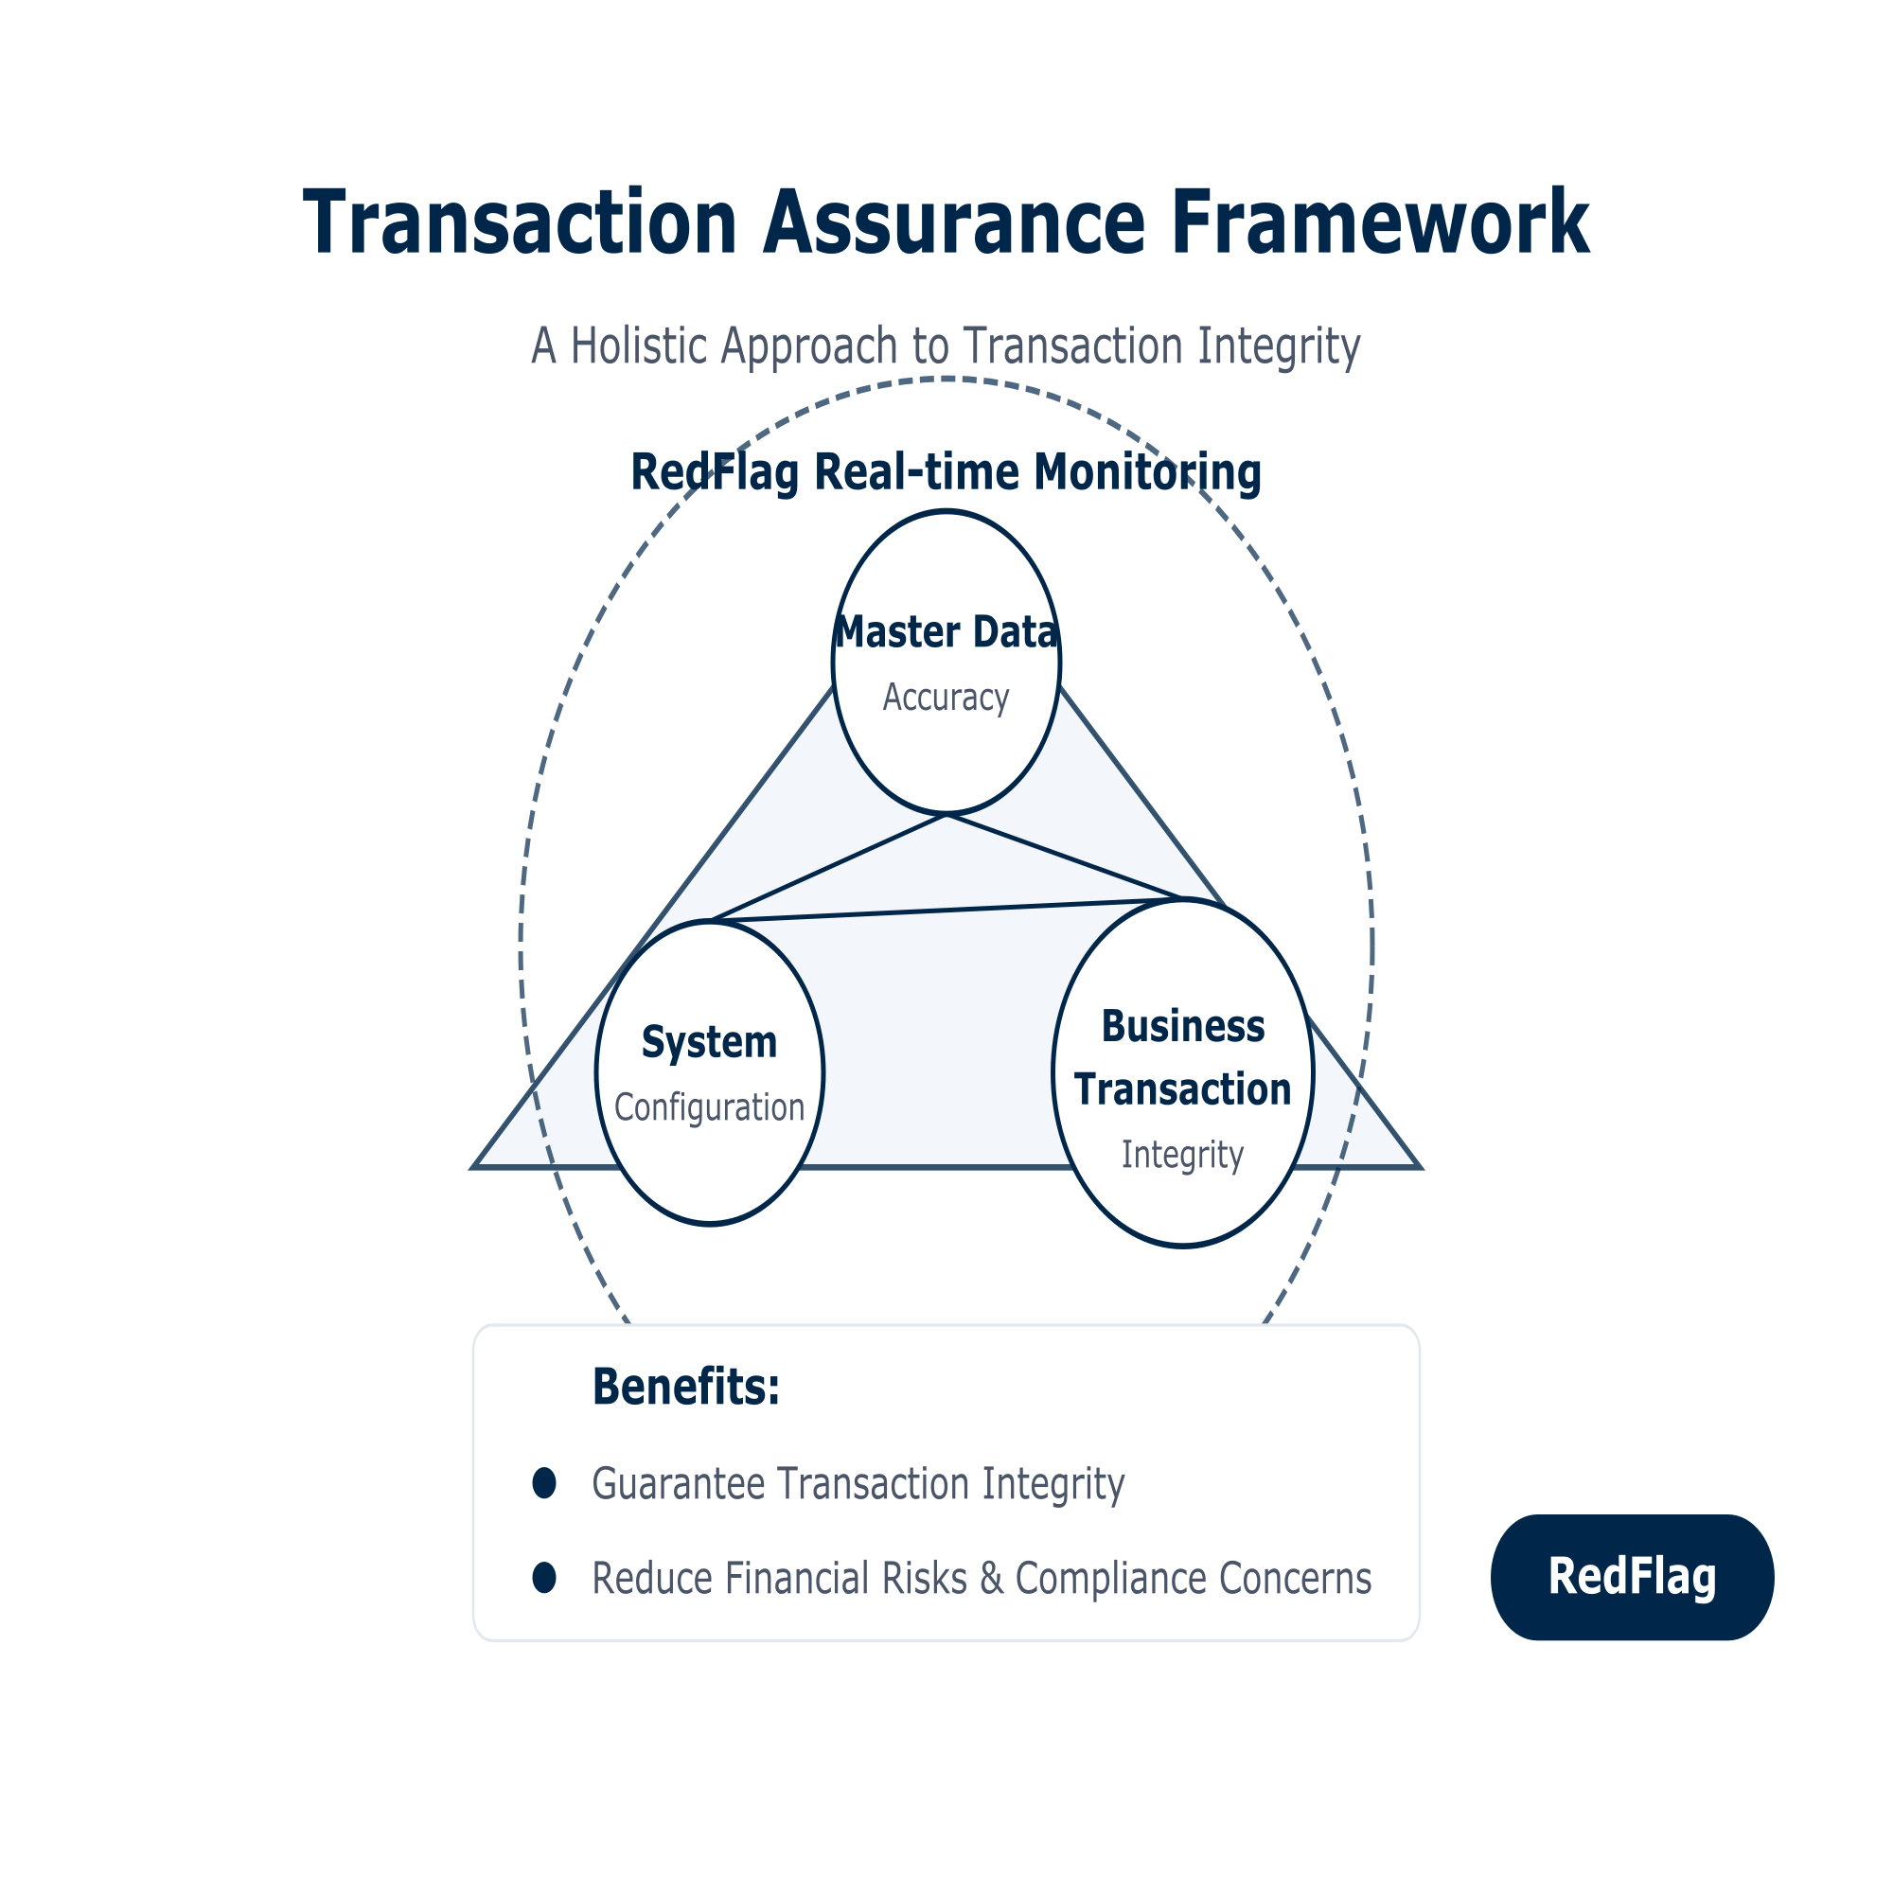
Business Challenge
Ensuring Business Integrity through Targeted Controls
Controls live in three silos: master data, system configurations and transactions
No dynamic grouping by control purpose or business strategy
Limited visibility into process breakdowns
Exposure to compliance gaps and financial risk

Slide 3
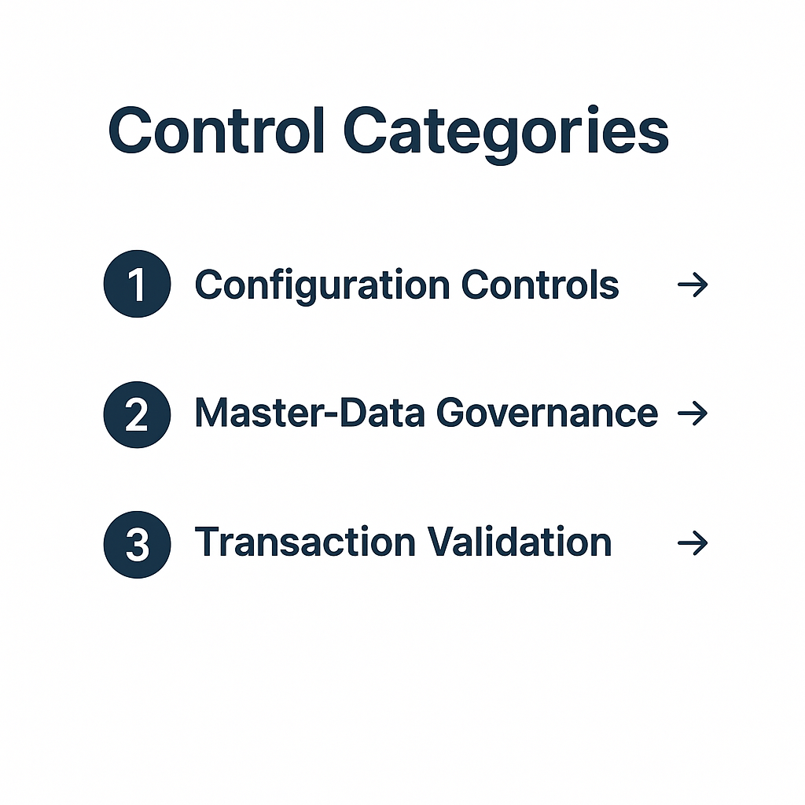
Strategic Value Through Digital Controls
The Redflag Advantage
Top-down grouping aligns every control with your business goals
Unified framework replaces hundreds of disconnected checks
Clear, purpose-driven insights for faster decision-making

Slide 4
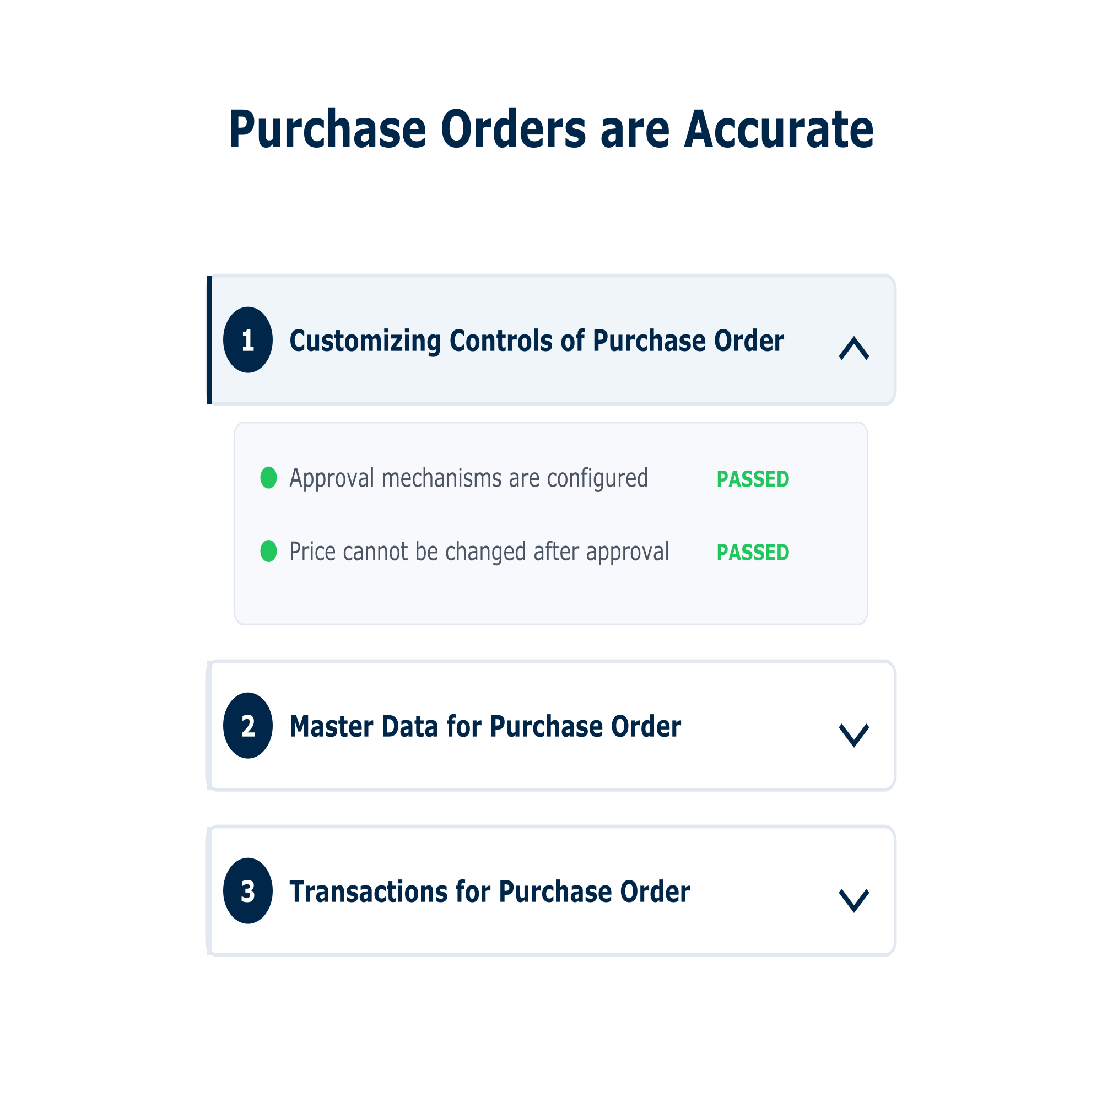
Strategic Value Through Digital Controls
The Redflag Advantage
The Customizing Controls section establishes the foundation of our control framework by focusing on system configuration.
Use Case: Uncontrolled PO configurations cause compliance risks
Manual adjustments
No approval enforcement
Price changes after approval
💡 Configured once = Prevents recurring errors

Slide 5
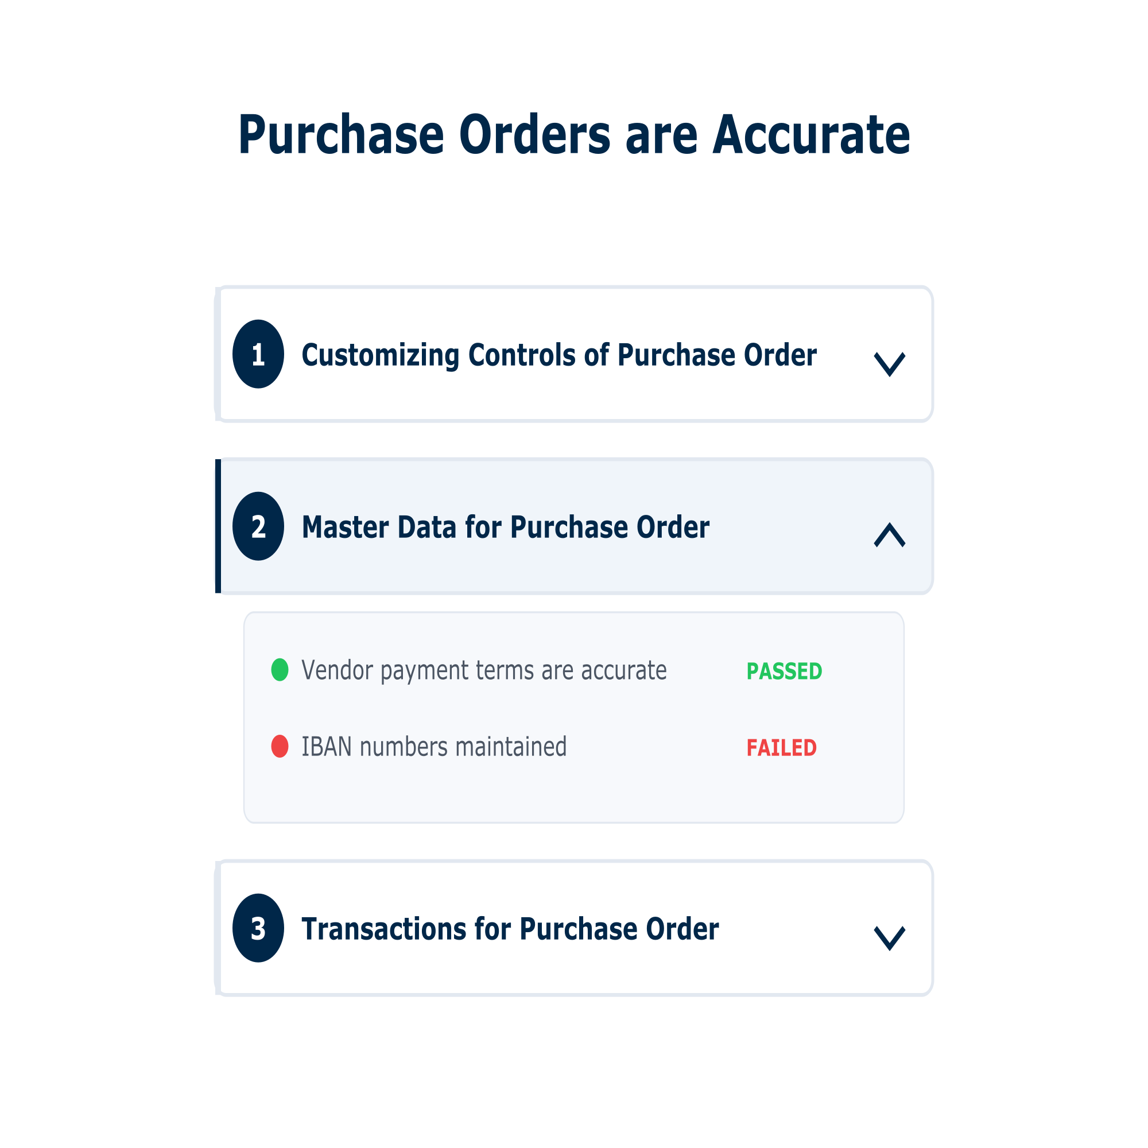
Strategic Value Through Digital Controls
The Redflag Advantage
Master Data quality directly impacts transaction accuracy.
Inaccurate master data leads to failed transactions
Invalid or missing IBANs
Wrong vendor payment terms
Unvalidated core records
💡 Clean master data = Clean transactions

Slide 6
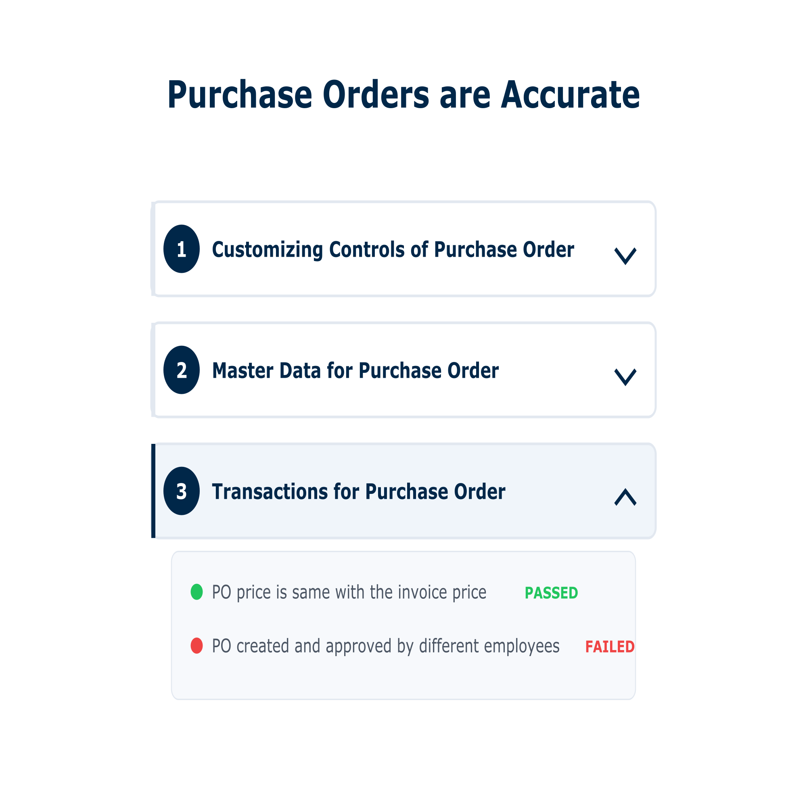
Business Challenge
The Redflag Advantage
The final layer examines operational execution in real-time.
Lack of visibility into real-time execution creates operational risk;
Same person creates and approves PO
No alert for duty segregation failure
Risks go undetected during operations
💡 Live checks = Immediate risk mitigation

Slide 7
Key Use Cases
Addressing procurement, payment, and sales risks with automated monitoring and controls.
🛒 Procure to Pay
📦 Order to Cash
Unauthorized Spend
Stops off-policy purchases → lowers financial risk
Invoice Mismatches
Fixes 3-way match issues before payment delays
Duplicate Payments
Catches repeated invoices before cash leaks
Payment Timing
Flags early/late payments affecting vendor trust
Vendor Master Data
Validates core info (e.g. IBAN) before transactions
⸻
Sales vs Delivery Gaps
Prevents lost revenue from order/delivery mismatches
Segregation of Duties
Blocks conflicts like same user approving own orders
Credit Limit Monitoring
Tracks credit changes with workflow enforcement
Price Anomalies
Detects unusual discounts, stops margin erosion
Customer Master Data
Protects accuracy, avoids payment issues

Slide 8

Application Overview
Clear, Quick, Reliable

Slide 9
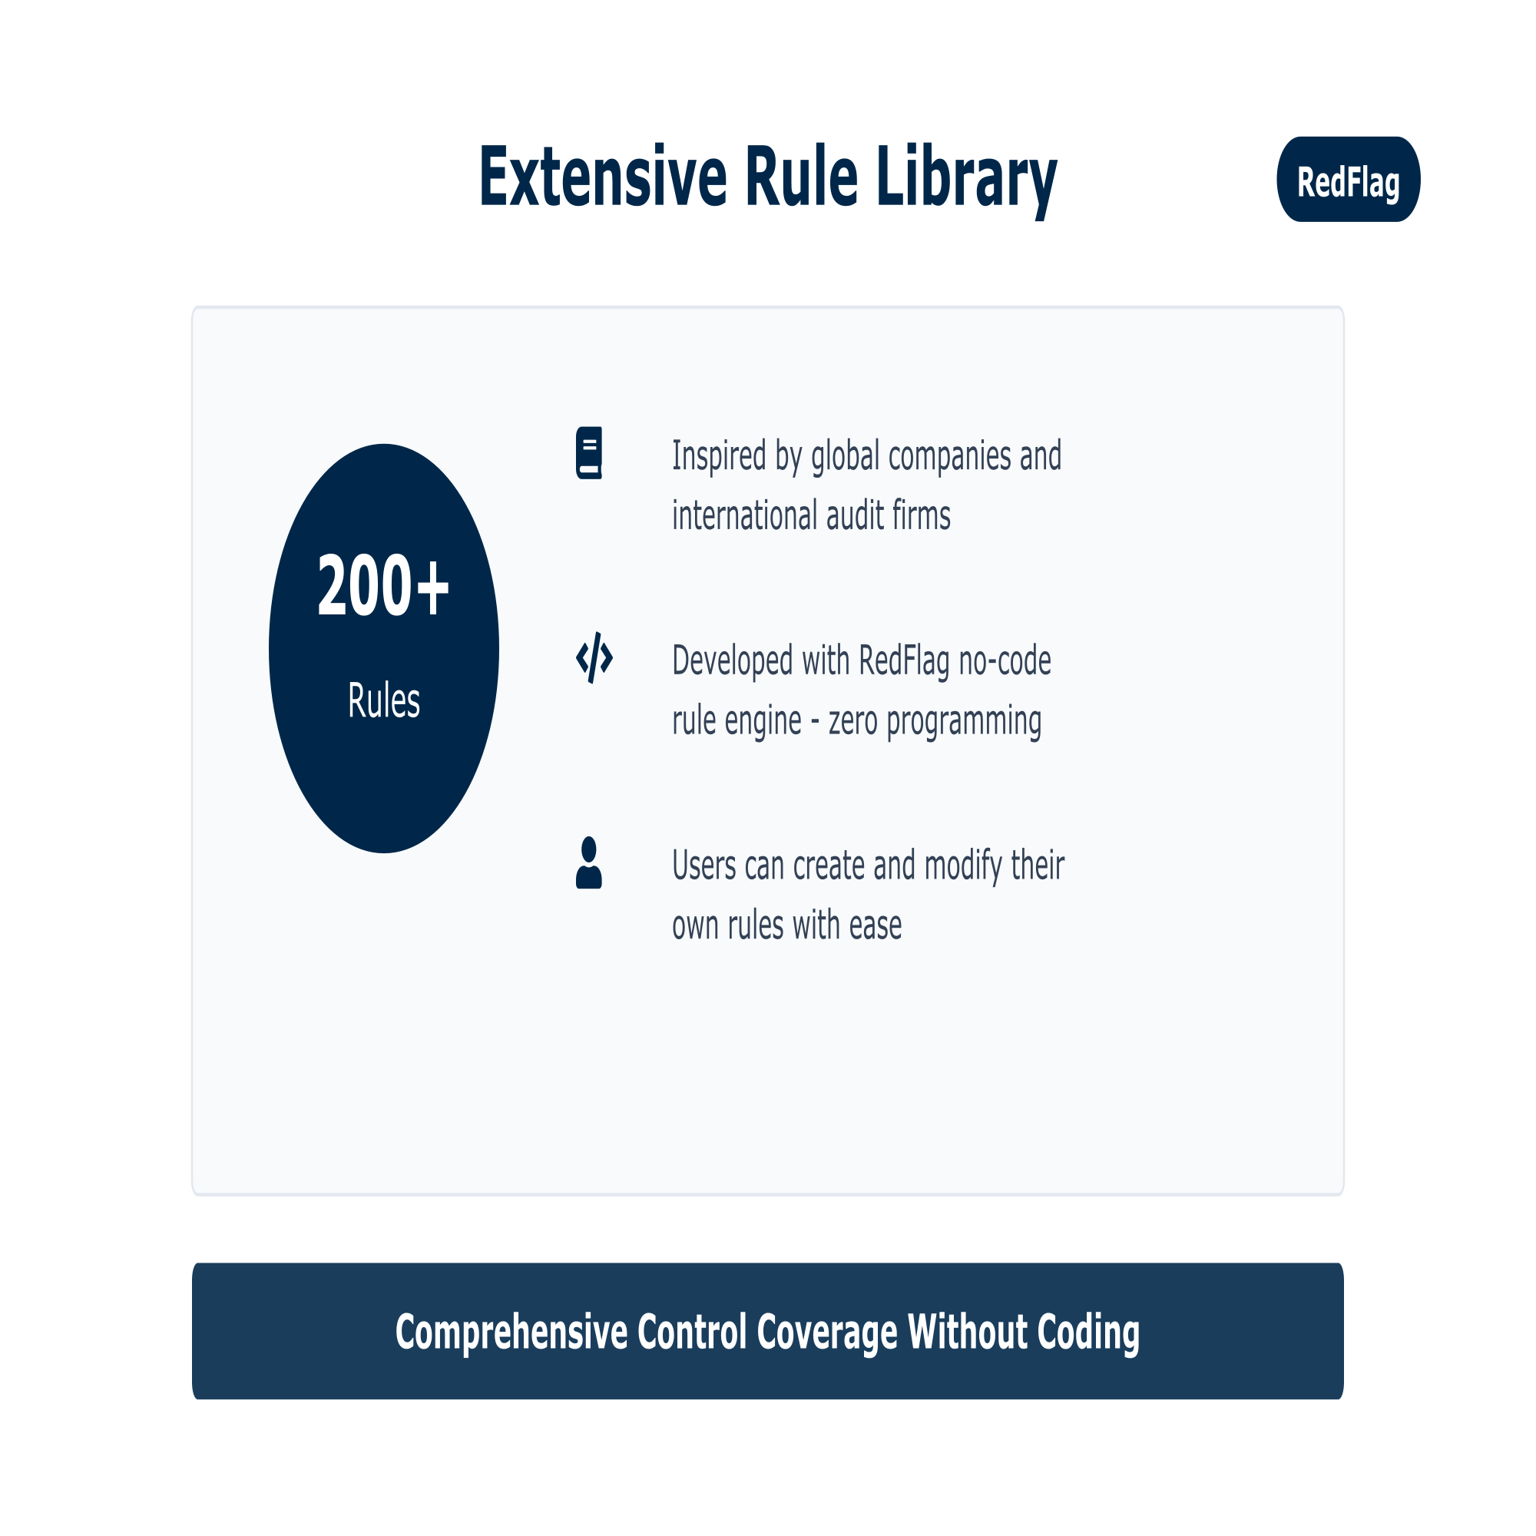

Slide 10
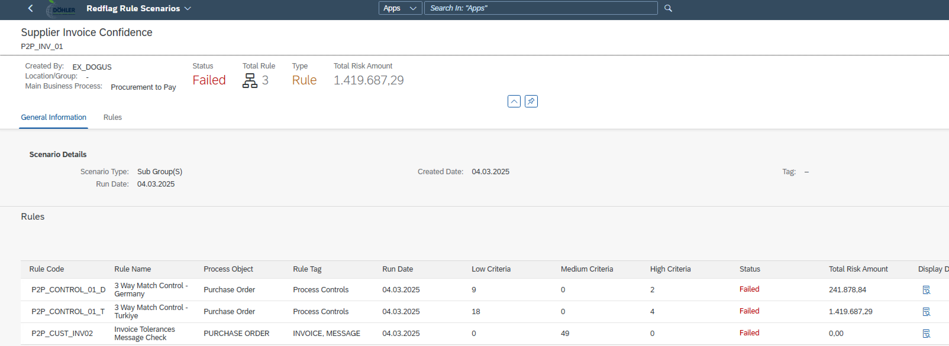
Use Case 1 : Confidence for 3-Way Match

Slide 11
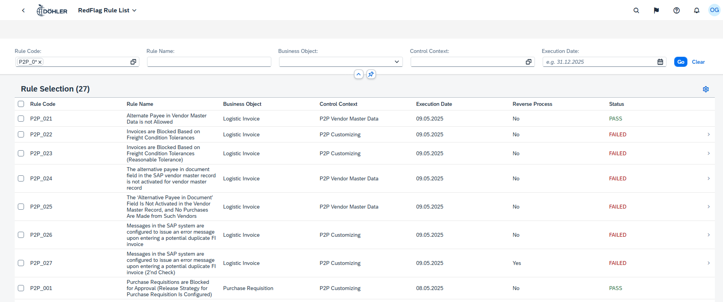
Use Case 2 : P2P Master Data & Customizing Controls

Slide 12
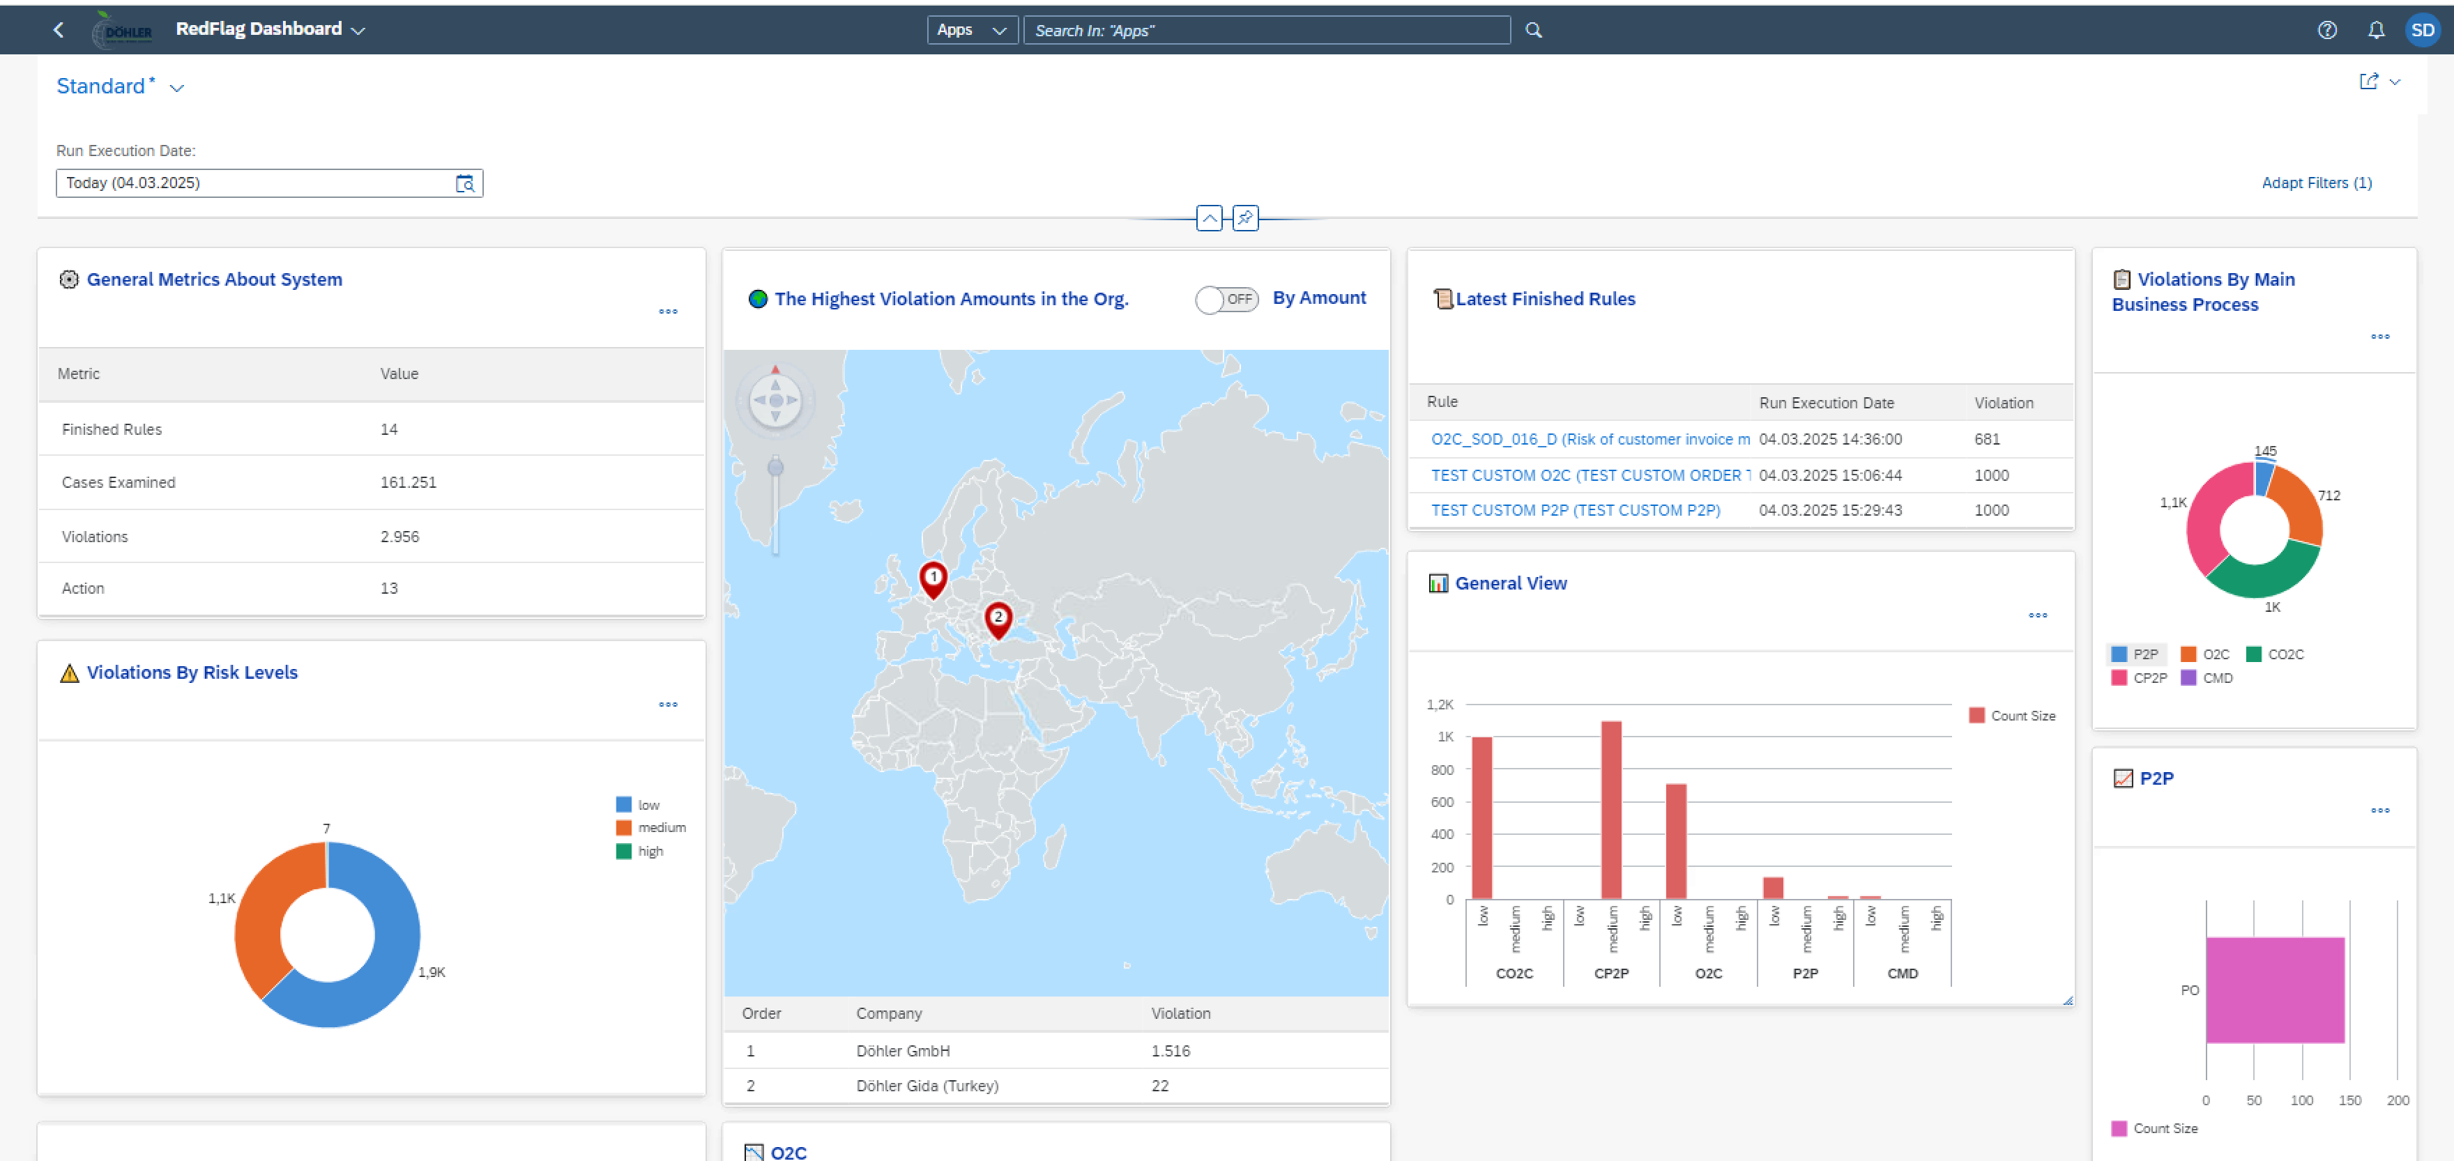
Control Cockpit

Slide 13

Implementation Timeline
Rapid Delivery, Maximum Impact
TASK / PROCESS
Day 1 -2
Day 3 - 4
Day 5 Go-Live
Activation of the solution
Tests & Trainings
Go-Live

Slide 14
Although the utmost care has been taken to prepare this material as accurately as possible, Solvia does not guarantee the accuracy, timeliness, completeness or merchantability for any purpose of any information contained in this document. The information contained herein is for informational purposes only and is subject to change without notice. © SOLVIA DIGITAL SOLUTIONS

